Slide 1
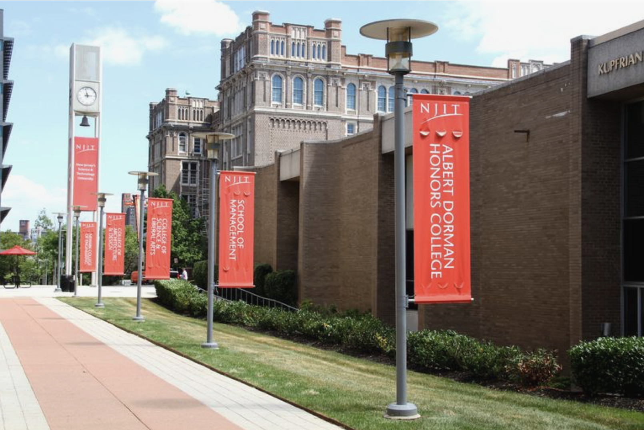
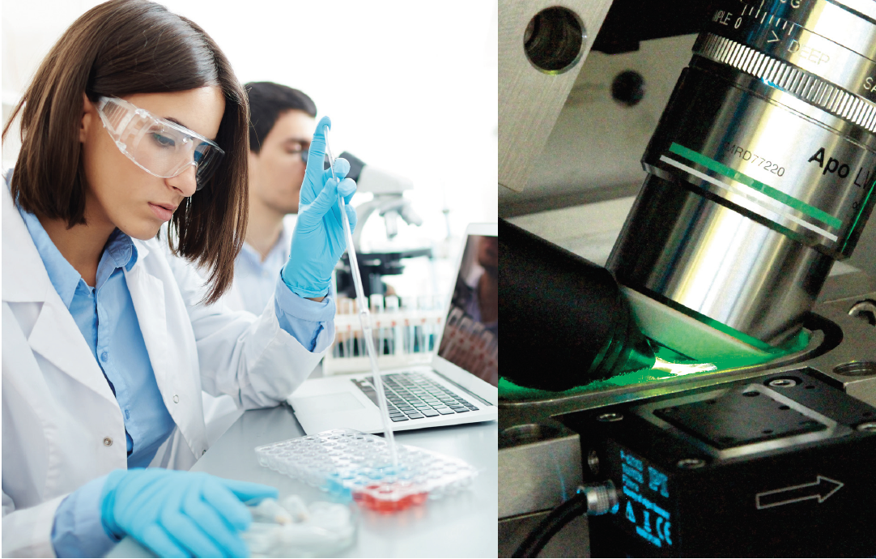
BioSensor Materials for Advanced Research and Technology (BioSMART)
at the Environment/Biotechnology Nexus
2024 Summer REU Program in Chemistry & Environmental Science
An Authentic 10-Week Research Experience at NJIT in the Department of Chemistry and Environmental Science
$6,000 stipends for the 10-weeks ($600/week), free accommodation and a host of professional development activities and industrial visits
Who should apply? College Juniors/rising seniors with an interest in chemistry, biochemistry, environmental science, nanotechnology, biosciences. Women and students from underrepresented groups in STEM are encouraged to apply.
US citizenship or permanent residency is required. Deadline for application March 1, 2024 or until all positions are filled.
Personal statement (~1,200 words), College Transcripts, and up to three letters of recommendation required
More information about the program is available by visiting https://centers.njit.edu/smart/about-biosmart-center/, or by contacting the PI (Dr. Wunmi Sadik at sadik@njit.edu) or the co-PI (Dr. Kevin Belfield at belfield@njit.edu).
For questions, please contact Genti Price by phone at 973 596-3371 or by e-mail at Genti.m.price@njit.edu

